Slide 1
Node.js Workshop for backend
Session 2 : HTTP and express.js

Slide 2
Table of contents
02
04
01
HTTP
REST API
What is HTTP?
What is REST API?
03
Node HTTP
Express.js
How to create a server using node http module
Introduction to exress.js

Slide 3
01
HTTP
What is HTTP?

Slide 4

What is HTTP?
HTTP is a protocol that allows computers to communicate over the internet.
It is like a language that web browsers and web servers use to exchange information.
HTTP is used for many other purposes, such as uploading files, sending forms, or controlling devices connected to the internet.

Slide 5
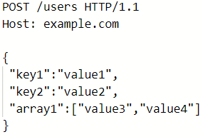
The structure of HTTP
HTTP messages are composed of two parts:
The header contains information about the message, such as the type of request (GET, POST, PUT, UPDATE, or DELETE), the URL of the resource, and more.
The body contains the actual data of the message, such as the HTML code of a web page, the image file of a picture, or the form data of a user input.

Slide 6
02
REST APIs
What is REST APIs?

Slide 7
What is API?
SERVER
API is a part of the server that defines how client applications can communicate with the server
The server provides an API that the client can use to send requests and receive responses.
API

Slide 8
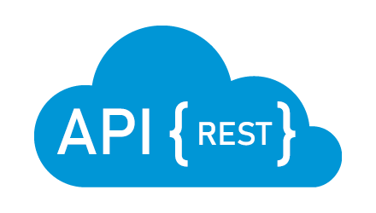
What is REST APIs?
REST APIs are a way of creating web services that allow different applications to communicate and exchange data over the internet.
REST APIs follow a set of principles and guidelines to ensure consistency and efficiency in the communication.

Slide 9
03
Node HTTP
How to create a server using node http module

Slide 10
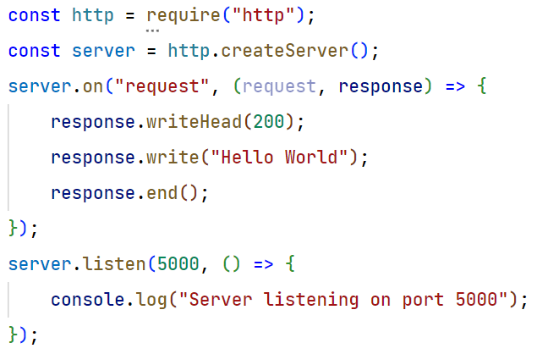
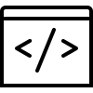
Create server with pure node.js

Slide 11
15 min task (1)
Create a node server with 3 endpoints:
/users
/admins
/posts
If we send http GET request to any of them respond with “Hello from [endpoint-name]”
Bonus: return status code 200 with the response.

Slide 12

04
Express.js
Introduction to express.js

Slide 13
What is express.js?
Fast, minimalist web framework for Node.js
Express.js does not impose much structure or rules on your code, which gives you more freedom and control over how you build your web application or API.
Express.js is one of the most popular web frameworks for Node.js, with millions of downloads and thousands of users. It is also used by many large and successful companies, such as Netflix, Uber, IBM, PayPal, and more

Slide 14
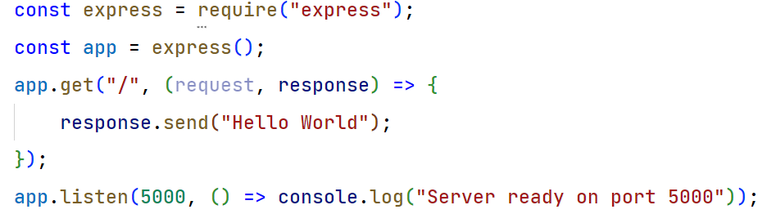
Create server with express

Slide 15

Routing
Routing refers to determining how an application responds to a client request to a particular endpoint, which is a URI (or path) and a specific HTTP request method (GET, POST, and so on).
(req, res) => { res.send(‘Hello world’) }
const app = express()
/home, /login, /users, …
GET, POST, DELETE,…

Slide 16
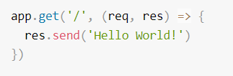
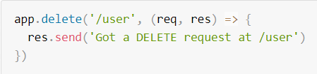
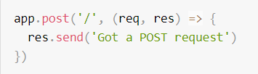
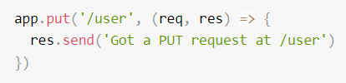
Basic Routing

Slide 17
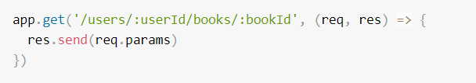

Routing parameters
Route parameters are named URL segments that are used to capture the values specified at their position in the URL.
The captured values are populated in the req.params object

Slide 18
16 min task (2)
Create an express server with three endpoints:
/users
/admins
/posts
Write the code to handle:
GET for /users/:userId In the response return “here is user [userId]”
POST for /admins the request body has {“name”: “ ”, “password”: “ ”} in the response return “admin [name] added”
DELETE for /posts/:postId In the response return “post [postId] deleted”

Slide 19
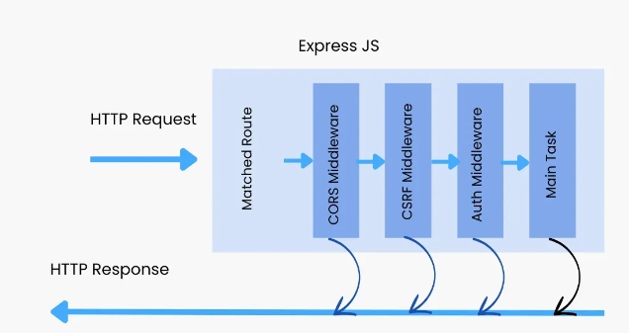
Express middlewares
Express is a routing and middleware web framework that has minimal functionality of its own.
An Express application is essentially a series of middleware function calls.
Middleware functions are functions that have access to the request object (req), the response object (res), and the next middleware function in the application’s request-response cycle

Slide 20
Express middlewares
Middlewares can perform the following tasks:
Execute any code.
Make changes to the request and the response objects.
End the request-response cycle.
Call the next middleware function in the stack.

Slide 21
Built-in middlewares
express.json()
built-in middleware function in Express. It parses incoming requests with JSON payloads, then populate the body object. inside the request
express.text()
built-in middleware function in Express. It parses incoming requests with text payloads , then populate the body object.
express.static()
built-in middleware function in Express. It serves static files such as HTML files, images.

Slide 22
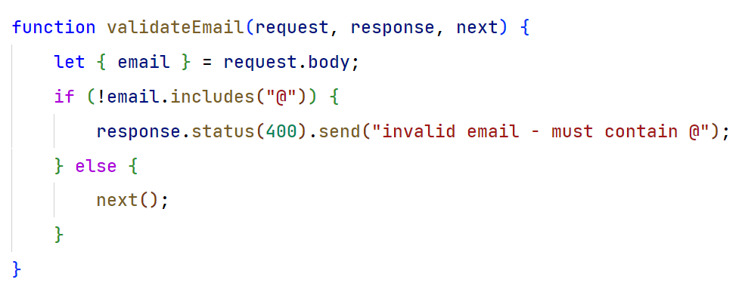
Custom middlewares

Slide 23
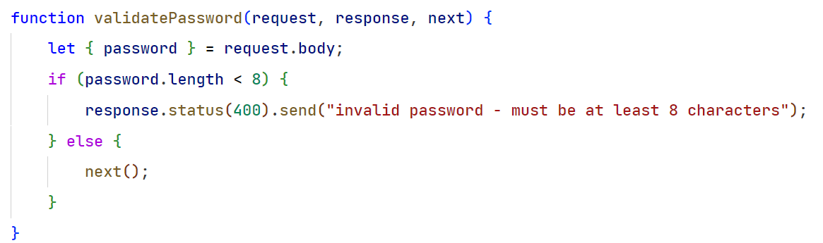
Custom middlewares cont.

Slide 24
Middlewares in action
400 Invalid
400 Invalid
200 valid
validateEmail
validatePasswd
Email: a@mail.com
Pass: 123456
Request handler
Email: a.mail.com
Pass: 12345678
Email: a@mail.com
Pass: 12345678

Slide 25
15 min task (3)
Create a /signup route with the following specs:
Username must not have any spaces.
Password must be at least 8 length.
Email must contain @
All previous validations must be implemented using middlewares.
Bonus: password should contain at least uppercase, lowercase, and a number.

Slide 26
Project assignment
Blogging website : phase 1

Slide 27
Description “Backend”
Create a variable to be used as a database for now to store all user data and blogs
Build your API with the following endpoints:
GET /users | Get all the users in the database
GET /users/:userId | Get a specific user
POST /users | Add new user (signup page)
GET /blogs | Get all blog posts from the database
GET /blogs/:blogId | Get a specific blog post
POST /blogs | Add new blog post

Slide 28
Description “Frontend” optional
Create 4 pages, (Signup, Login, Account, and feed).
Login and signup pages consists of a navbar and form for login or signup.
Account page has a navbar, user info section, and blogs written by the user.
Feed page has a navbar and all the blogs written by all the users on the platform.
Design the frontend to depend on the backend to fetch all the data (don’t hardcode user data or user blog posts).

Slide 29
Thank You

